Slide 1
LOAN MANAGEMENT SYSTEM
PRESENTED BY
MYSQL PROJECT
SARANYA T

Slide 2
SQL (Structured Query Language)
SQL, or Structured Query Language, is a standard programming language designed for managing and manipulating relational databases.
It’s used to interact with databases performing tasks like querying data, updating records, inserting new data, and deleting old data.
SQL works best with structured data organized into tables with rows and columns.

Slide 3
Introduction
A Relational Database Management System (RDBMS)
Supports standard SQL (Structured Query Language)
It provides multi-user access
Works on many platforms
Supports multi storage engines
An Open-Source software
Secure Data Protection

Slide 4
Microsoft SQL Server
MySQL Server
Oracle Database
PostgreSQL Server
MongoDB Server
Navigation Server
NoSQL Server
Types of SQL Server

Slide 5
SQL Statements
DML-Data Manipulation Language
DDL-Data Definition Language
DCL –Data Control Language
DQL –Data Query language
TCL-Transaction Control Language

Slide 6
SQL Statements
DDL | DML | DQL | DCL | TCL
CREATE | MERGE | SELECT | GRANT | COMMIT
ALTER | INSERT |  | REVOKE | ROLLBACK
DROP | UPDATE |  | DENY | SAVEPOINT
TRUNCATE | DELETE |  |  | SET TRANSACTION
RENAME | MERGE

Slide 7
TYPES OF JOINS
INNER JOIN
LEFT JOIN
RIGHT JOIN
UNION/ FULL
OUTER JOIN

Slide 8
Most Important SQL Statements
SELECT - extracts data from a database (DQL)
UPDATE - updates data in a database (DML)
DELETE - deletes data from a database (DML)
INSERT - inserts new data into a database (DML)
CREATE DATABASE - creates a new database (DDL)
CREATE TABLE - creates a new table (DDL)
DROP TABLE - deletes a table (DDL)

Slide 9
Objectives:
The Loan Management System Project focuses on managing loan applications efficiently by integrating data from customer income, loan status, and geographical details. It classifies applicants based on income, calculates interest rates, and uses triggers to monitor loan statuses and CIBIL scores for approval or rejection. The system also updates customer information, ensures data consistency through joins, and filters key data like high CIBIL scores and corporate clients. Outputs are stored as procedures to automate tasks, aiding in informed decision-making for loan approvals and risk assessment.

Slide 10
Data Set
customer income status
Loan status
Customer info
Country state
Region info

Slide 11
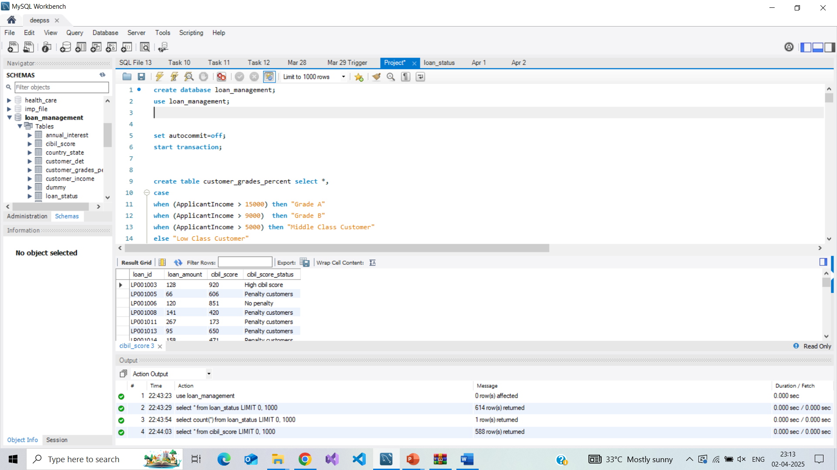
Creating Database
Creation & Using Of The Database :
To control transactions manually, you need to turn off Auto Commit.

Slide 12
1.Set customer criteria based on applicant income select
Criteria
Applicant income >15,000 = grade a
Applicant income >9,000 = grade b
Applicant income >5000 = middle class customer
Other wise low class
(Create this as new table)
Monthly interest percentage
Criteria
Applicant income <5000 rural=3%
Applicant income <5000 semi rural=3.5%
Applicant income <5000 urban=5%
Applicant income <5000 semi urban= 2.5%
Otherwise =7%

Slide 13
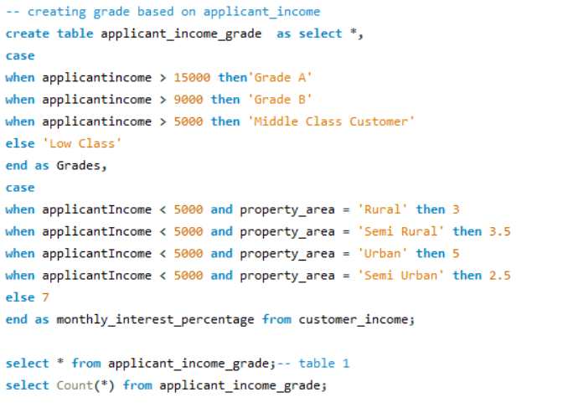
OUTPUT

Slide 14
Criteria
Statement level trigger
CRITERIA:
Cibil score >900 high cibil score
Cibil score >750 no penalty
Cibil score >0 penalty customers
Cibil score <=0 reject customers (loan cannot apply)
Row level trigger Criteria
CRITERIA:
Loan amt null = loan still processing

Slide 15
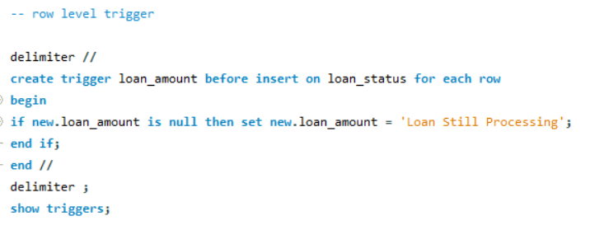
Create Row Level Trigger For Loan Amt
A BEFORE INSERT row-level trigger executes before a new row is inserted into a table.
It allows you to validate, modify, or set default values before the data is saved.

Slide 16
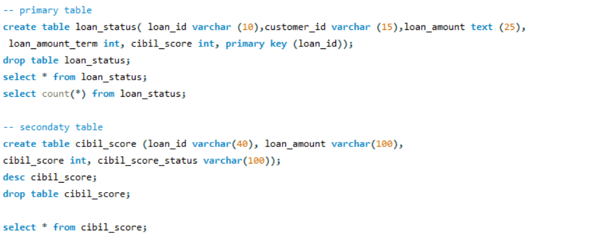
CREATING PRIMARY AND SECONDARY TABLE

Slide 17
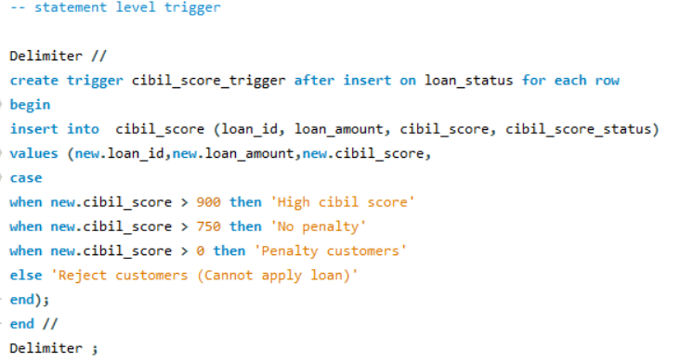
QUERY FOR STATEMENT LEVEL TRIGGER
AFTER INSERT in a statement-level trigger executes once per INSERT statement, regardless of how many rows are inserted. It is commonly used for logging, auditing, and enforcing rules across multiple rows.

Slide 18


Then delete the reject and loan still processing customers
Update loan as integers
Create all the above fields as a table

Slide 19
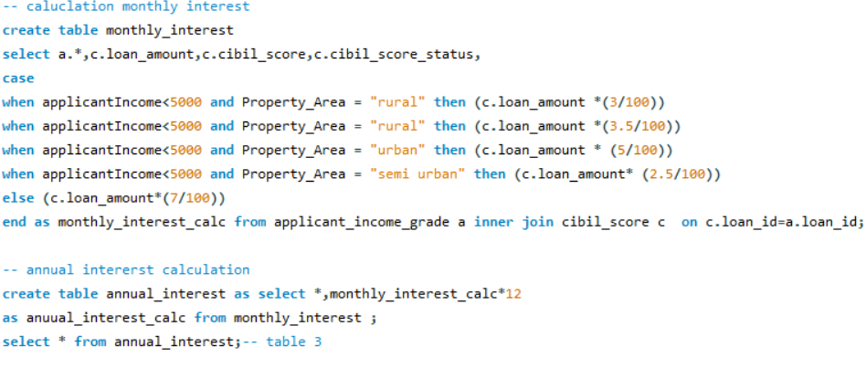
Calculate monthly interest amt and annual interest amt based on loan amt

Slide 20
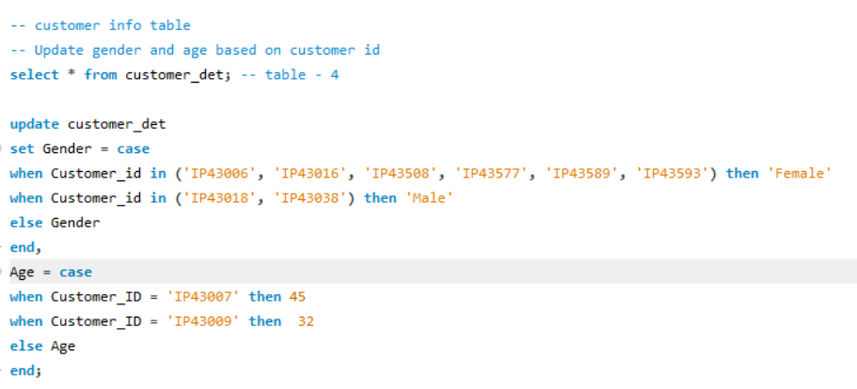
IMPORT TABLE CUSTOMER_INFO
Update gender and age based on customer id

Slide 21
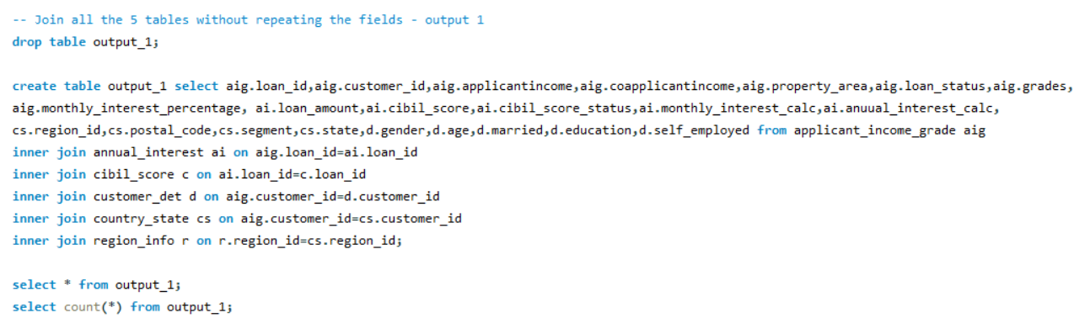
JOINING ALL TABLE 5 TABLE WITHOUT REPEATING FIELDS

Slide 22
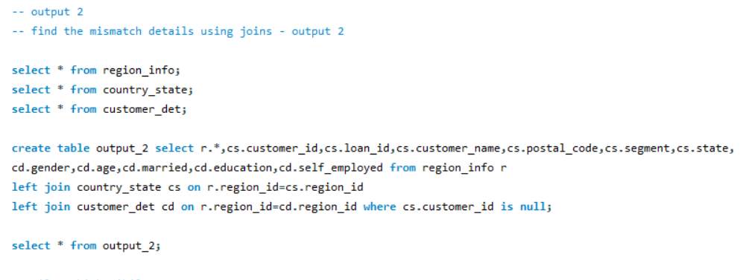
FIND THE MISMATCH DETAILS USING JOINS

Slide 23
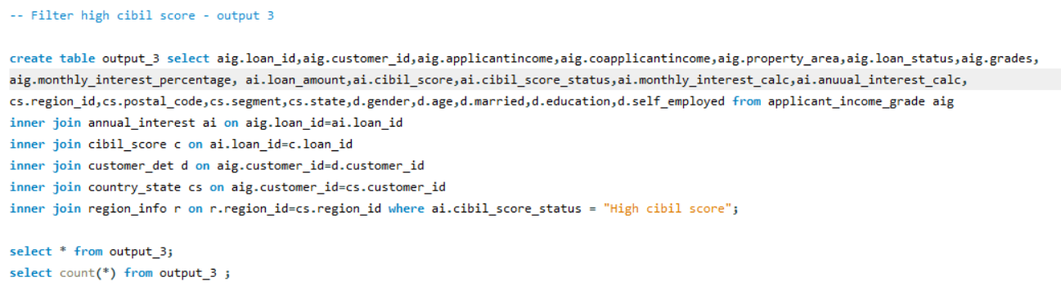
FILTERING INFORMATION USING INNER JOIN

Slide 24
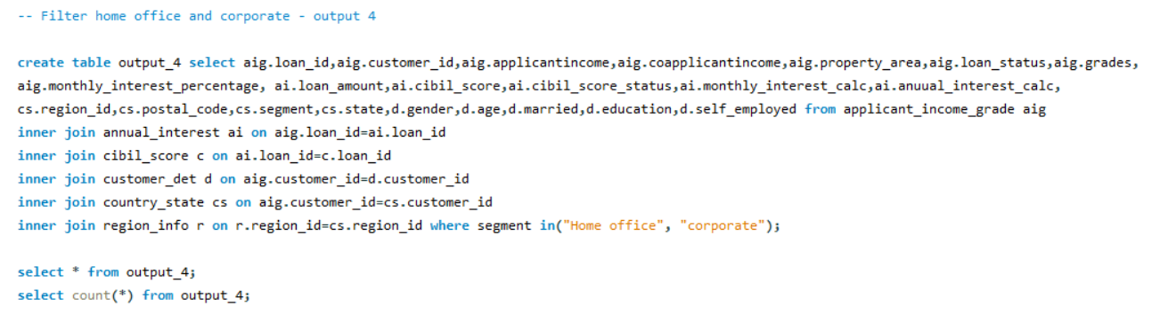
FILTERING HOME OFFICE AND CORPORATE

Slide 25
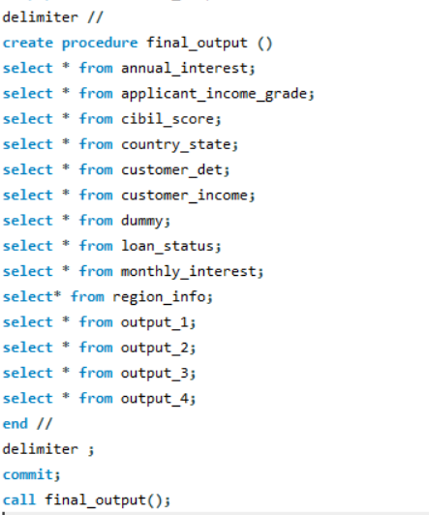
STORE ALL THE OUTPUT AS PROCEDURE
Procedure :
A Stored Procedure in MySQL is a precompiled block of SQL statements that can be executed as a single unit. It helps automate repetitive tasks, improve performance, and enhance security.

Slide 26

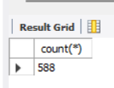
COUNTING THE NUMBER AND ROWS AFTER UPDATING AND DELETING THE VALUES
QUERY
OUTPUT

Slide 27
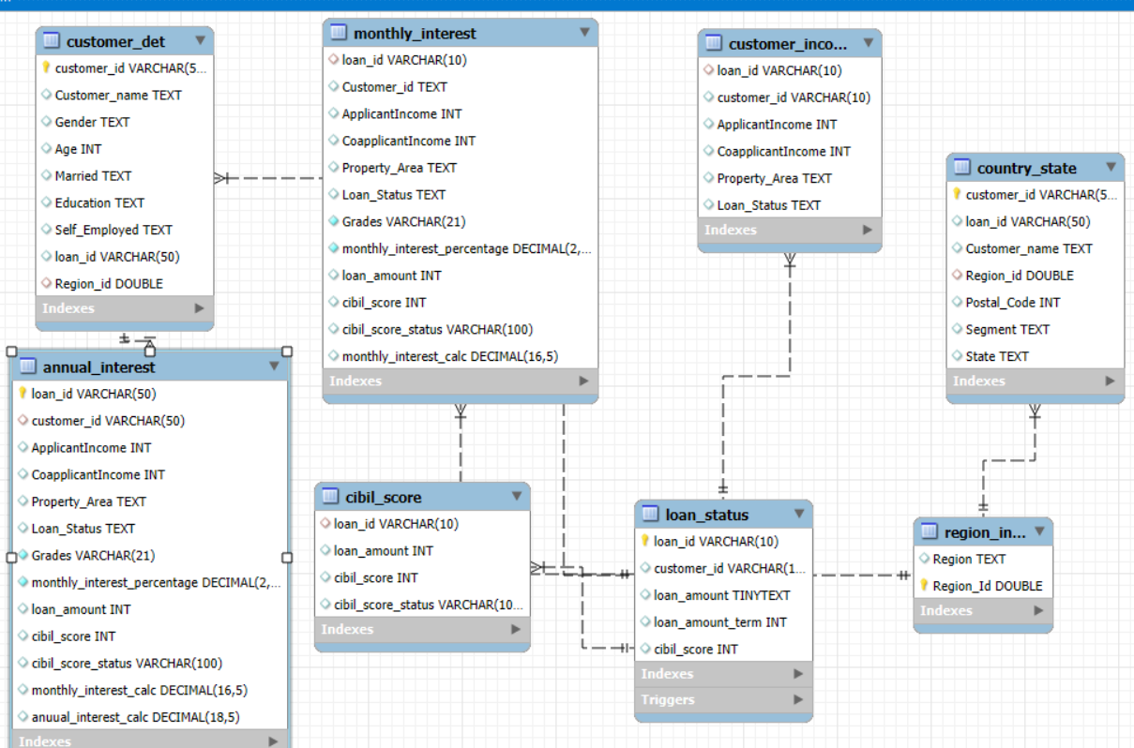
EER Diagram(Enhanced Entity Relationship Diagram):​
​

Slide 28


